Slide 1
Deep learning for text and sequences
Dr. Noman Islam
Module-III
PIAIC, Pakistan

Slide 2
Introduction
The two fundamental deep-learning algorithms for sequence processing are recurrent neural networks and 1D convnets
Applications of these algorithms include the following:
Document classification and timeseries classification, such as identifying the topic of an article or the author of a book
Timeseries comparisons, such as estimating how closely related two documents or two stock tickers are?

Slide 3
Sequence-to-sequence learning, such as decoding an English sentence into French
Sentiment analysis, such as classifying the sentiment of tweets or movie reviews as positive or negative
Timeseries forecasting, such as predicting the future weather at a certain location, given recent weather data

Slide 4
Working with text data
It can be understood as either a sequence of characters or a sequence of words, but it’s most common to work at the level of words.
None of deeplearning models (that we study) truly understand text in a human sense;
Rather, these models can map the statistical structure of written language, which is sufficient to solve many simple textual tasks
Deep learning for natural-language processing is pattern recognition applied to words, sentences, and paragraphs, in much the same way that computer vision is pattern recognition applied to pixels.

Slide 5
Converting text to numerical data
Like all other neural networks, deep-learning models don’t take as input raw text: they only work with numeric tensors.
Vectorizing text is the process of transforming text into numeric tensors.
This can be done in multiple ways:
Segment text into words, and transform each word into a vector.
Segment text into characters, and transform each character into a vector.
Extract n-grams of words or characters, and transform each n-gram into a vector. N-grams are overlapping groups of multiple consecutive words or characters.

Slide 6
All text-vectorization processes consist of applying some tokenization scheme and then associating numeric vectors with the generated tokens.
There are multiple ways to associate a vector with a token.
The two major ones are: one-hot encoding of tokens, and token embedding (typically used exclusively for words, and called word embedding).

Slide 7
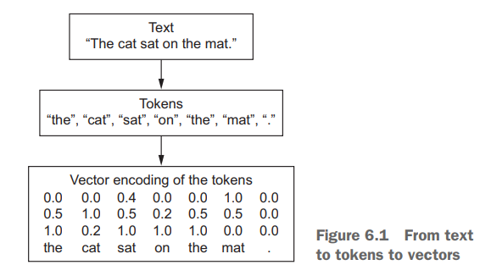

Slide 8
One hot encoding
One-hot encoding is the most common, most basic way to turn a token into a vector
It consists of associating a unique integer index with every word and then turning this integer index i into a binary vector of size N (the size of the vocabulary); the vector is all zeros except for the ith entry, which is 1.
Of course, one-hot encoding can be done at the character level, as well.

Slide 9
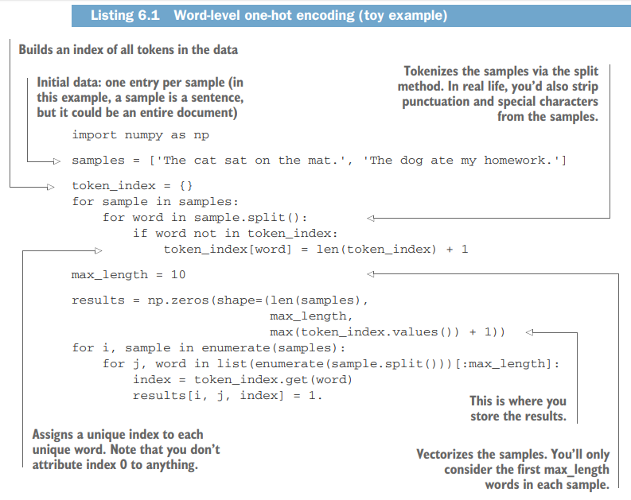

Slide 10
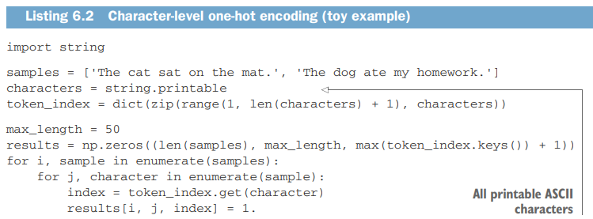

Slide 11
Note that Keras has built-in utilities for doing one-hot encoding of text at the word level or character level, starting from raw text data.
You should use these utilities, because they take care of a number of important features such as stripping special characters from strings and only taking into account the N most common words in your dataset (a common restriction, to avoid dealing with very large input vector spaces).

Slide 12
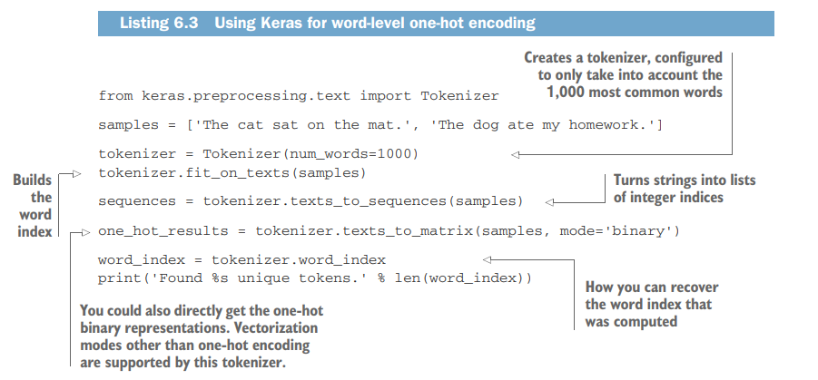

Slide 13
Using word embeddings
Another popular and powerful way to associate a vector with a word is the use of dense word vectors, also called word embeddings.
Whereas the vectors obtained through one-hot encoding are binary, sparse (mostly made of zeros), and very high-dimensional (same dimensionality as the number of words in the vocabulary), word embeddings are lowdimensional floating-point vectors (that is, dense vectors, as opposed to sparse vectors);

Slide 14
Unlike the word vectors obtained via one-hot encoding, word embeddings are learned from data.
It’s common to see word embeddings that are 256-dimensional, 512-dimensional, or 1,024-dimensional when dealing with very large vocabularies.
On the other hand, one-hot encoding words generally leads to vectors that are 20,000-dimensional or greater (capturing a vocabulary of 20,000 tokens, in this case)

Slide 15
Two ways to obtain word-embeddings
Learn word embeddings jointly with the main task you care about (such as document classification or sentiment prediction). In this setup, you start with random word vectors and then learn word vectors in the same way you learn the weights of a neural network.
Load into your model word embeddings that were precomputed using a different machine-learning task than the one you’re trying to solve. These are called pretrained word embeddings

Slide 16
LEARNING WORD EMBEDDINGS WITH THE EMBEDDING LAYER
The simplest way to associate a dense vector with a word is to choose the vector at random
The geometric relationships between word vectors should reflect the semantic relationships between these words.
Word embeddings are meant to map human language into a geometric space
You would expect synonyms to be embedded into similar word vectors
You would expect the geometric distance (such as L2 distance) between any two word vectors to relate to the semantic distance between the associated words

Slide 17
For instance, by adding a “female” vector to the vector “king,” we obtain the vector “queen.”
By adding a “plural” vector, we obtain “kings.” Word-embedding spaces typically feature thousands of such interpretable and potentially useful vectors.
It’s reasonable to learn a new embedding space with every new task.
Fortunately, backpropagation makes this easy, and Keras makes it even easier.

Slide 18

from keras.layers import Embedding
embedding_layer = Embedding(1000, 64)
The Embedding layer takes as input a 2D tensor of integers, of shape (samples, sequence_length), where each entry is a sequence of integers.
Sequences that are shorter than others should be padded with zeros, and sequences that are longer should be truncated.

Slide 19
This layer returns a 3D floating-point tensor of shape (samples, sequence_ length, embedding_dimensionality).
Such a 3D tensor can then be processed by an RNN layer or a 1D convolution layer
When you instantiate an Embedding layer, its weights (its internal dictionary of token vectors) are initially random, just as with any other layer.
During training, these word vectors are gradually adjusted via backpropagation, structuring the space into something the downstream model can exploit.

Slide 20
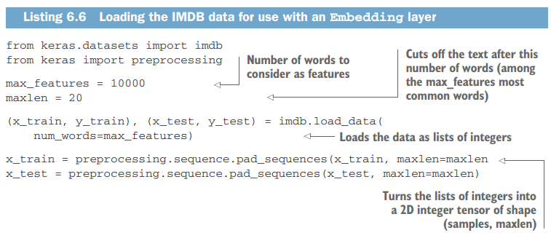
Embedding and IMDB Movie Review

Slide 21
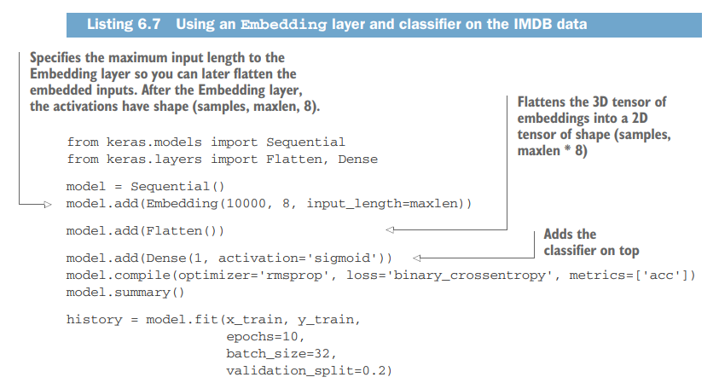

Slide 22
You get to a validation accuracy of ~76%, which is pretty good considering that you’re only looking at the first 20 words in every review.
But note that merely flattening the embedded sequences and training a single Dense layer on top leads to a model that treats each word in the input sequence separately, without considering inter-word relationships and sentence structure (for example, this model would likely treat both “this movie is a bomb” and “this movie is the bomb” as being negative reviews).

Slide 23
It’s much better to add recurrent layers or 1D convolutional layers on top of the embedded sequences to learn features that take into account each sequence as a whole.
That’s what we’ll focus on in the next few sections.

Slide 24
USING PRETRAINED WORD EMBEDDINGS
Instead of learning word embeddings jointly with the problem you want to solve, you can load embedding vectors from a precomputed embedding space that you know is highly structured and exhibits useful properties—that captures generic aspects of language structure.
The rationale behind using pretrained word embeddings in natural-language processing is much the same as for using pretrained convnets in image classification

Slide 25
Word2Vec
The idea of a dense, lowdimensional embedding space for words, computed in an unsupervised way, was initially explored by Bengio et al. in the early 2000s, but it only started to take off in research and industry applications after the release of one of the most famous and successful word-embedding schemes: the Word2vec algorithm (https://code.google.com/ archive/p/word2vec), developed by Tomas Mikolov at Google in 2013.
Word2vec dimensions capture specific semantic properties, such as gender

Slide 26
There are various precomputed databases of word embeddings that you can download and use in a Keras Embedding layer.
Word2vec is one of them.
Another popular one is called Global Vectors for Word Representation (GloVe, https://nlp.stanford .edu/projects/glove), which was developed by Stanford researchers in 2014

Slide 27
Download raw IMDB dataset
http://mng.bz/0tIo
Now, let’s collect the individual training reviews into a list of strings, one string per review.
You’ll also collect the review labels (positive/negative) into a labels list.

Slide 28
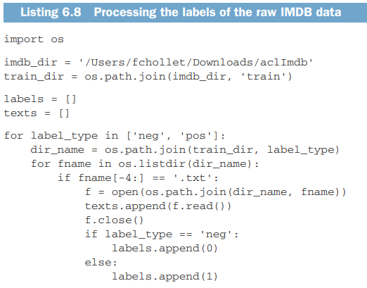

Slide 29
Tokenize the data
Because pretrained word embeddings are meant to be particularly useful on problems where little training data is available (otherwise, task-specific embeddings are likely to outperform them), we’ll add the following twist: restricting the training data to the first 200 samples.
So you’ll learn to classify movie reviews after looking at just 200 examples.

Slide 30
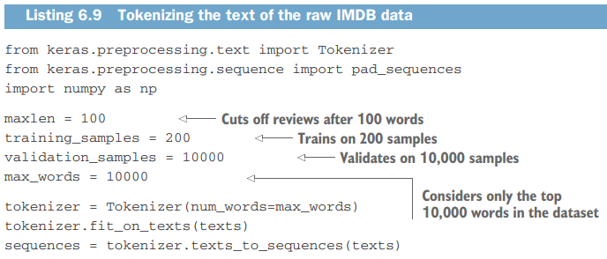
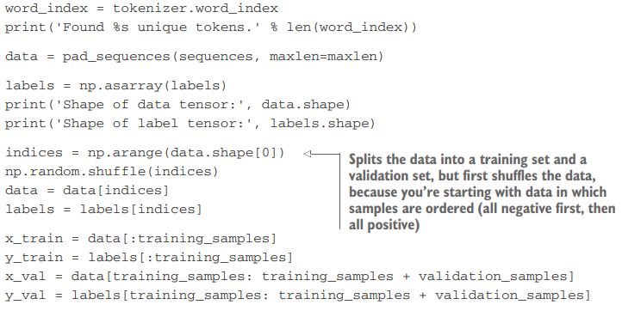

Slide 31
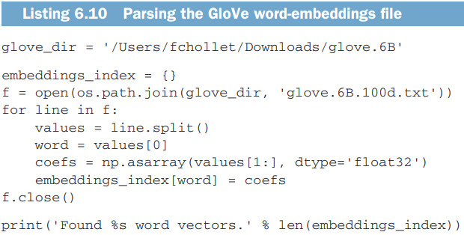
Download Glove Embeddings
https://nlp.stanford.edu/projects/glove

Slide 32
Building an Embedding matrix
Next, you’ll build an embedding matrix that you can load into an Embedding layer.
It must be a matrix of shape (max_words, embedding_dim), where each entry i contains the embedding_dim-dimensional vector for the word of index i in the reference word index (built during tokenization).

Slide 33
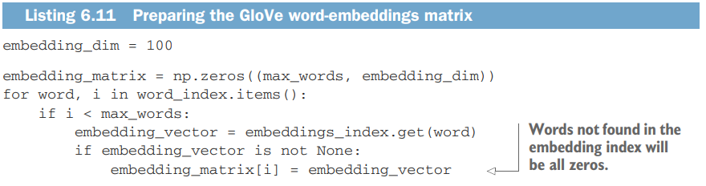

Slide 34
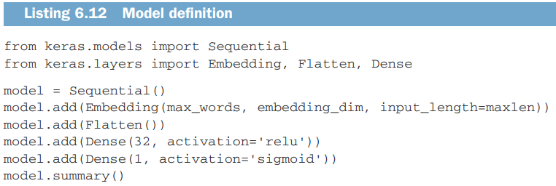
Defining the model

Slide 35
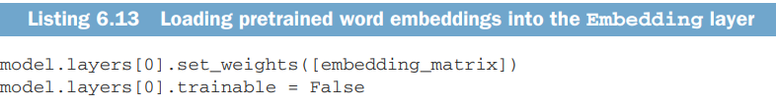
Loading the GLOVE embeddings
The Embedding layer has a single weight matrix: a 2D float matrix where each entry i is the word vector meant to be associated with index i.
Additionally, you’ll freeze the Embedding layer

Slide 36
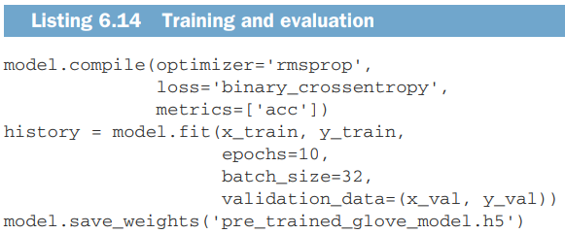
Compile and Train the model

Slide 37
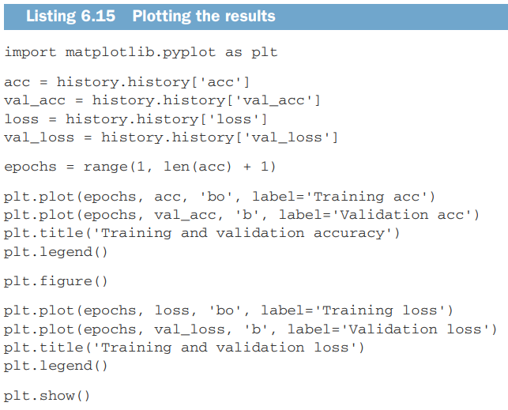

Slide 38
The model quickly starts overfitting, which is unsurprising given the small number of training samples.
Validation accuracy has high variance for the same reason, but it seems to reach the high 50s

Slide 39
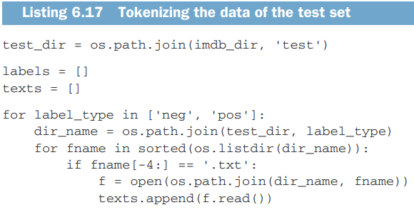
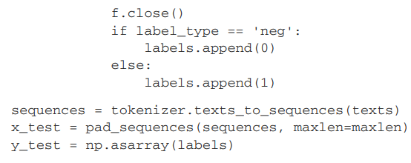
Evaluating model

Slide 40
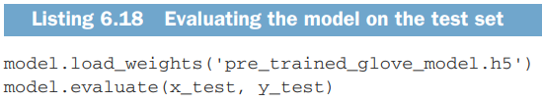

Slide 41
Recurrent Neural Network
A major characteristic of all neural networks you’ve seen so far, such as densely connected networks and convnets, is that they have no memory
With such networks, in order to process a sequence or a temporal series of data points, you have to show the entire sequence to the network at once: turn it into a single data point
In contrast, as you’re reading the present sentence, you’re processing it word by word

Slide 42
A recurrent neural network (RNN) adopts the same principle, albeit in an extremely simplified version: it processes sequences by iterating through the sequence elements and maintaining a state containing information relative to what it has seen so far.
In effect, an RNN is a type of neural network that has an internal loop

Slide 43
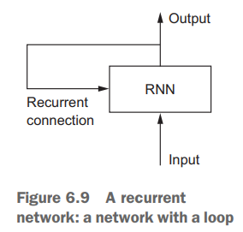

Slide 44
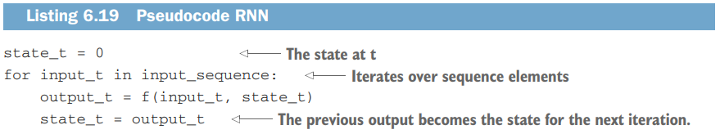
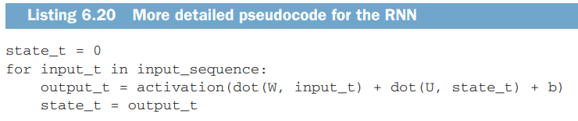

Slide 45
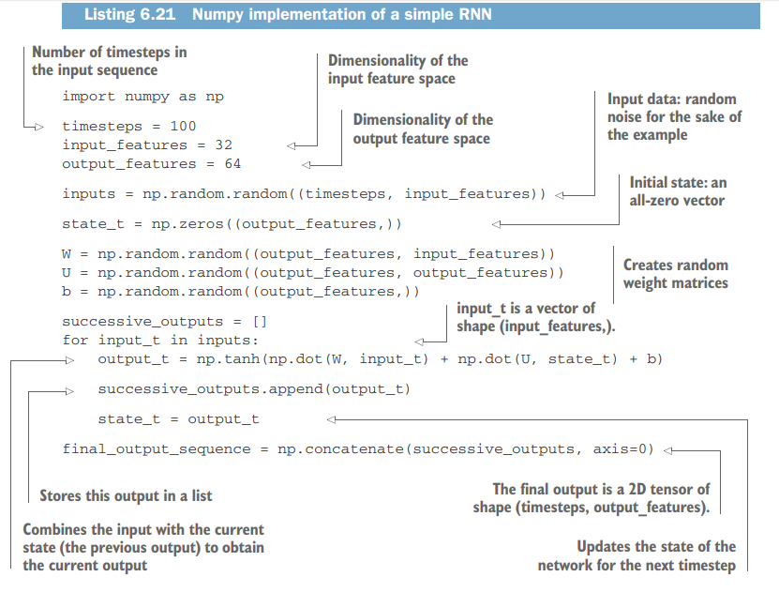

Slide 46
In summary, an RNN is a for loop that reuses quantities computed during the previous iteration of the loop, nothing more
The process you just naively implemented in Numpy corresponds to an actual Keras layer—the SimpleRNN layer:
from keras.layers import SimpleRNN
There is one minor difference: SimpleRNN processes batches of sequences, like all other Keras layers, not a single sequence as in the Numpy example

Slide 47
This means it takes inputs of shape (batch_size, timesteps, input_features), rather than (timesteps, input_features).
Like all recurrent layers in Keras, SimpleRNN can be run in two different modes:
it can return either the full sequences of successive outputs for each timestep (a 3D tensor of shape (batch_size, timesteps, output_features))
or only the last output for each input sequence (a 2D tensor of shape (batch_size, output_features)).
These two modes are controlled by the return_sequences constructor argument.

Slide 48
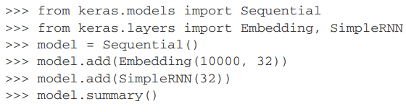
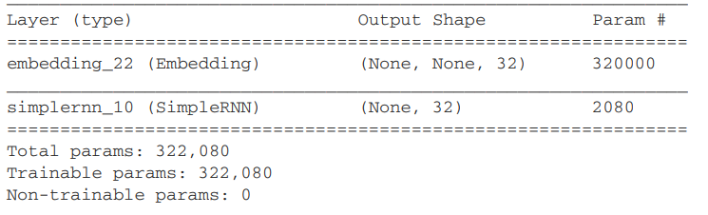

Slide 49
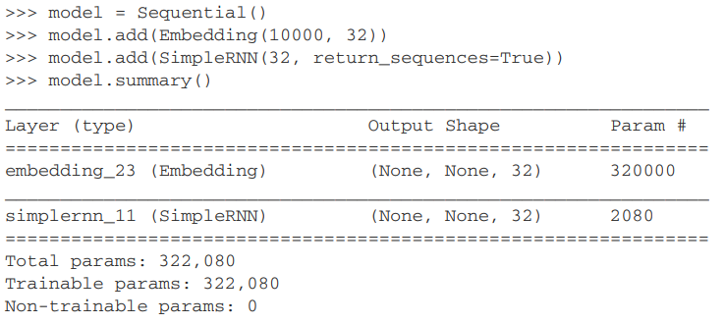

Slide 50
It’s sometimes useful to stack several recurrent layers one after the other in order to increase the representational power of a network.
In such a setup, you have to get all of the intermediate layers to return full sequence of outputs:

Slide 51
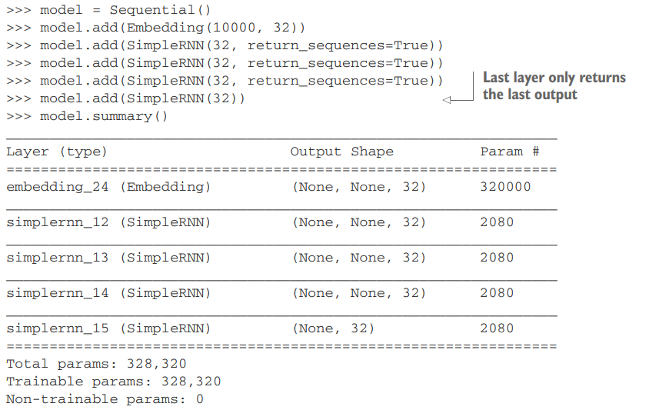

Slide 52
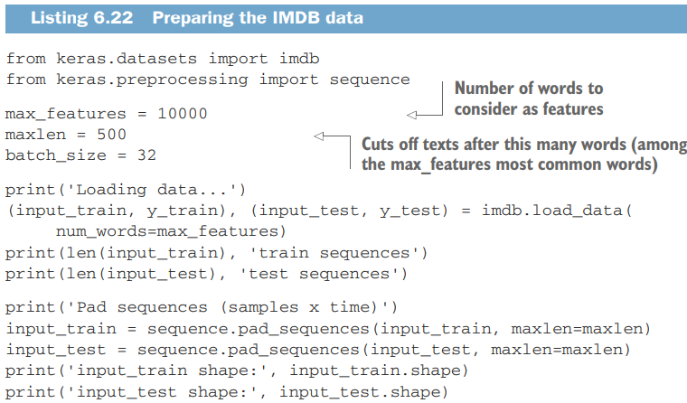

Slide 53
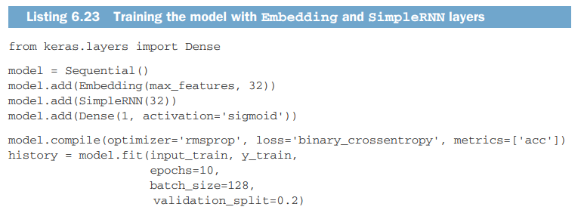

Slide 54
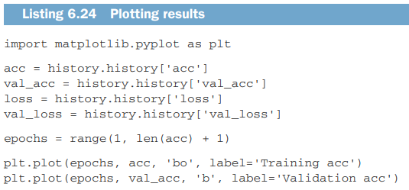
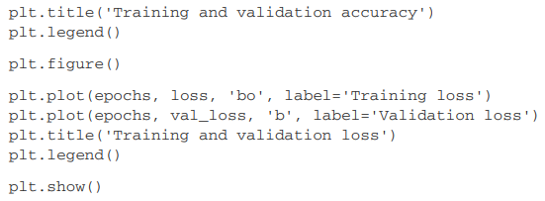

Slide 55
Understanding the LSTM and GRU layers
SimpleRNN isn’t the only recurrent layer available in Keras.
There are two others: LSTM and GRU
SimpleRNN has a major issue: although it should theoretically be able to retain at time t information about inputs seen many timesteps before, in practice, such long-term dependencies are impossible to learn.

Slide 56
This is due to the vanishing gradient problem, an effect that is similar to what is observed with non-recurrent networks (feedforward networks) that are many layers deep: as you keep adding layers to a network, the network eventually becomes untrainable.
The theoretical reasons for this effect were studied by Hochreiter, Schmidhuber, and Bengio in the early 1990s. The LSTM and GRU layers are designed to solve this problem.

Slide 57
LSTM
This layer is a variant of the SimpleRNN layer you already know about; it adds a way to carry information across many timesteps.
Imagine a conveyor belt running parallel to the sequence you’re processing.
Information from the sequence can jump onto the conveyor belt at any point, be transported to a later timestep, and jump off, intact, when you need it.
This is essentially what LSTM does: it saves information for later, thus preventing older signals from gradually vanishing during processing.

Slide 58
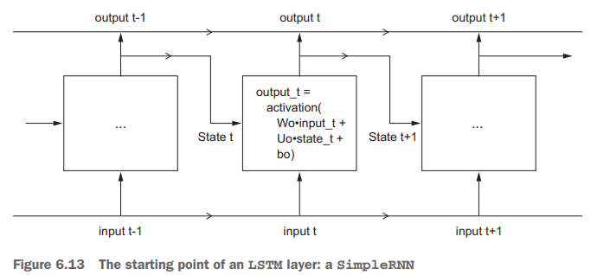

Slide 59
Let’s add to this picture an additional data flow that carries information across timesteps.
Call its values at different timesteps Ct, where C stands for carry.

Slide 60
This information will have the following impact on the cell: it will be combined with the input connection and the recurrent connection (via a dense transformation: a dot product with a weight matrix followed by a bias add and the application of an activation function), and it will affect the state being sent to the next timestep (via an activation function an a multiplication operation).
Conceptually, the carry dataflow is a way to modulate the next output and the next state

Slide 61
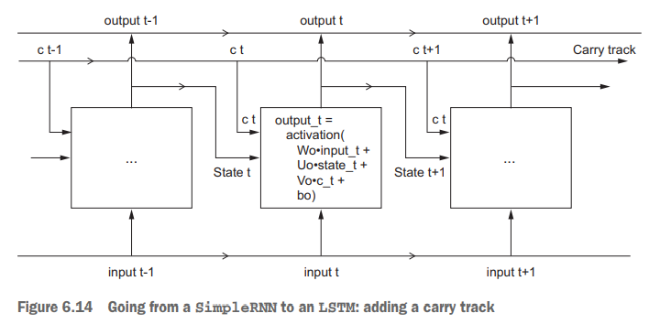

Slide 62
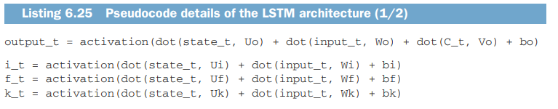


Slide 63
Multiplying c_t and f_t is a way to deliberately forget irrelevant information in the carry dataflow.
Meanwhile, i_t and k_t provide information about the present, updating the carry track with new information
What these operations actually do is determined by the contents of the weights parameterizing them; and the weights are learned in an end-to-end fashion, starting over with each training round, making it impossible to credit this or that operation with a specific purpose.

Slide 64
The combination of operations making up an RNN cell is better interpreted as a set of constraints on your search, not as a design in an engineering sense
Just keep in mind what the LSTM cell is meant to do: allow past information to be reinjected at a later time, thus fighting the vanishing-gradient problem.

Slide 65
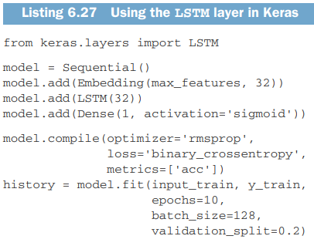

Slide 66
Advanced used of Recurrent Networks
We’ll cover the following techniques:
Recurrent dropout—This is a specific, built-in way to use dropout to fight overfitting in recurrent layers.
Stacking recurrent layers—This increases the representational power of the network (at the cost of higher computational loads).
Bidirectional recurrent layers—These present the same information to a recurrent network in different ways, increasing accuracy and mitigating forgetting issues.

Slide 67
A temperature forecasting problem
https://s3.amazonaws.com/keras-datasets/jena_climate_2009_2016.csv.zip

Slide 68
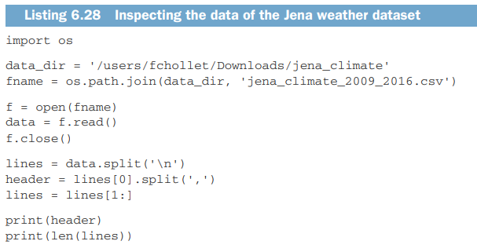

Slide 69
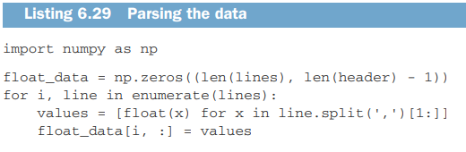

Slide 70
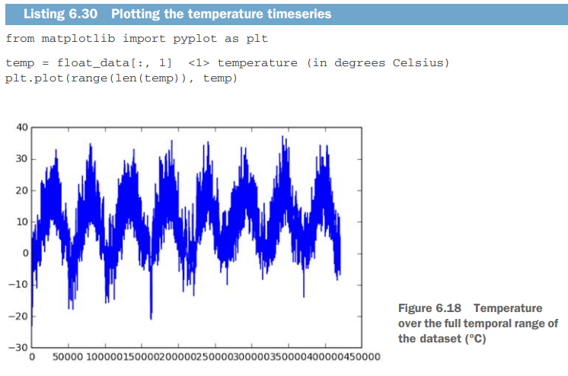

Slide 71
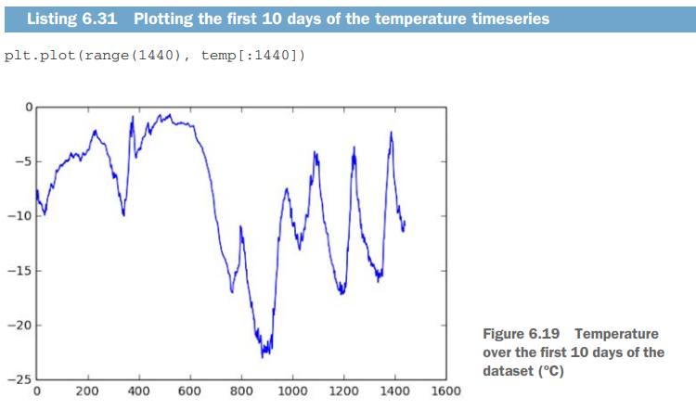

Slide 72
Preparing the data
The exact formulation of the problem will be as follows: given data going as far back as lookback timesteps (a timestep is 10 minutes) and sampled every steps timesteps, can you predict the temperature in delay timesteps? You’ll use the following parameter values:
lookback = 720—Observations will go back 5 days.
steps = 6—Observations will be sampled at one data point per hour.
delay = 144—Targets will be 24 hours in the future.

Slide 73
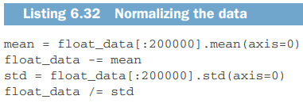

Slide 74
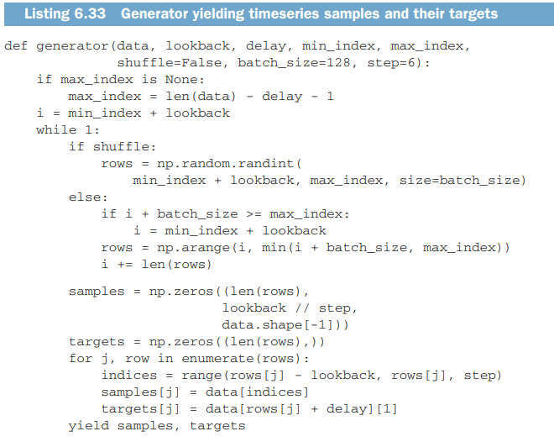

Slide 75
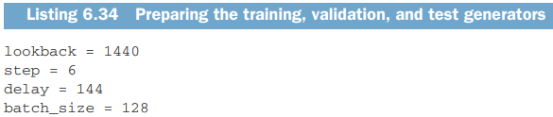

Slide 76
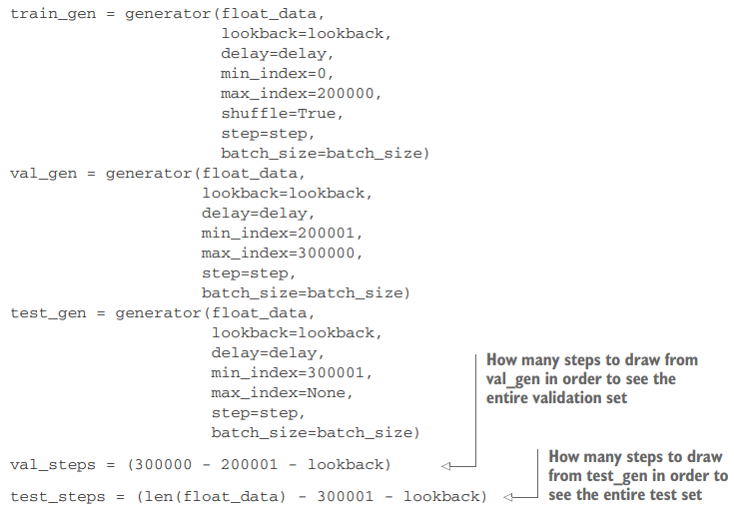

Slide 77
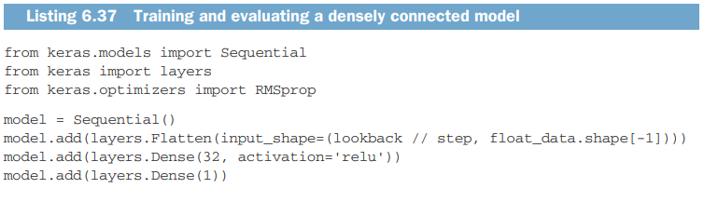
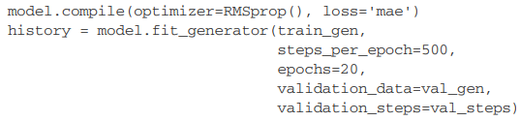

Slide 78
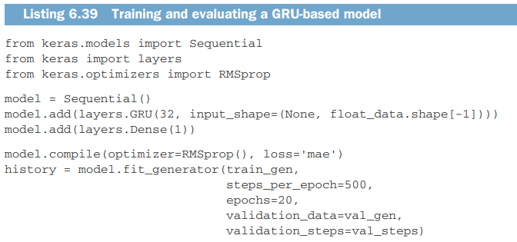

Slide 79
Using recurrent dropout to fight overfitting
It has long been known that applying dropout before a recurrent layer hinders learning rather than helping with regularization.
In 2015, Yarin Gal, as part of his PhD thesis on Bayesian deep learning,6 determined the proper way to use dropout with a recurrent network: the same dropout mask (the same pattern of dropped units) should be applied at every timestep, instead of a dropout mask that varies randomly from timestep to timestep.

Slide 80
What’s more, in order to regularize the representations formed by the recurrent gates of layers such as GRU and LSTM, a temporally constant dropout mask should be applied to the inner recurrent activations of the layer (a recurrent dropout mask).
Using the same dropout mask at every timestep allows the network to properly propagate its learning error through time; a temporally random dropout mask would disrupt this error signal and be harmful to the learning process.

Slide 81
Every recurrent layer in Keras has two dropout-related arguments: dropout, a float specifying the dropout rate for input units of the layer, and recurrent_dropout, specifying the dropout rate of the recurrent units.

Slide 82
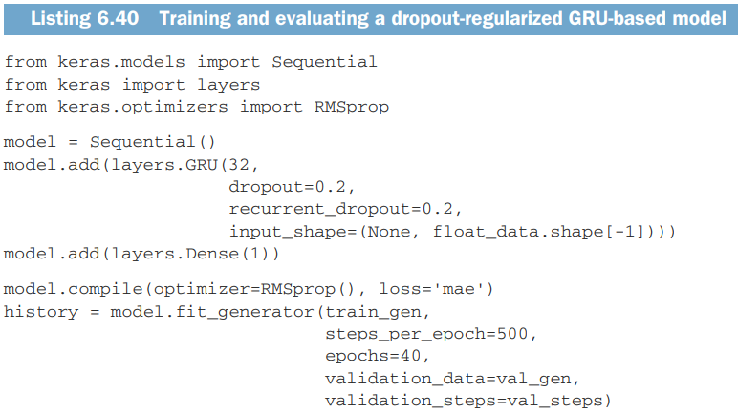

Slide 83
Stacking recurrent layers
You should consider increasing the capacity of the network.
Increasing network capacity is typically done by increasing the number of units in the layers or adding more layers.
Recurrent layer stacking is a classic way to build more-powerful recurrent networks: for instance, what currently powers the Google Translate algorithm is a stack of seven large LSTM layers—that’s huge.

Slide 84
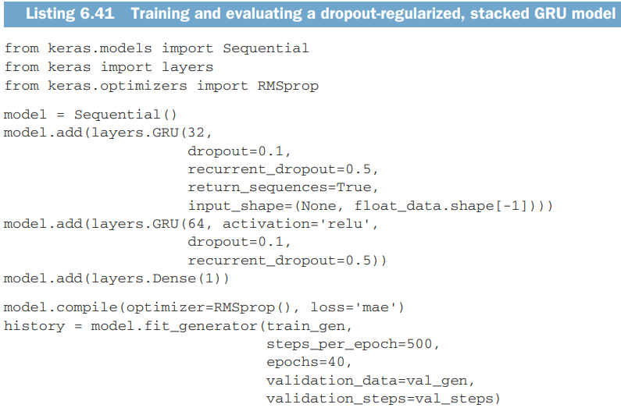

Slide 85
Using bidirectional RNNs
It’s frequently used in natural-language processing
RNNs are notably order dependent, or time dependent: they process the timesteps of their input sequences in order, and shuffling or reversing the timesteps can completely change the representations the RNN extracts from the sequence.
A bidirectional RNN exploits the order sensitivity of RNNs: it consists of using two regular RNNs, each of which processes the input sequence in one direction (chronologically and antichronologically), and then merging their representations.

Slide 86
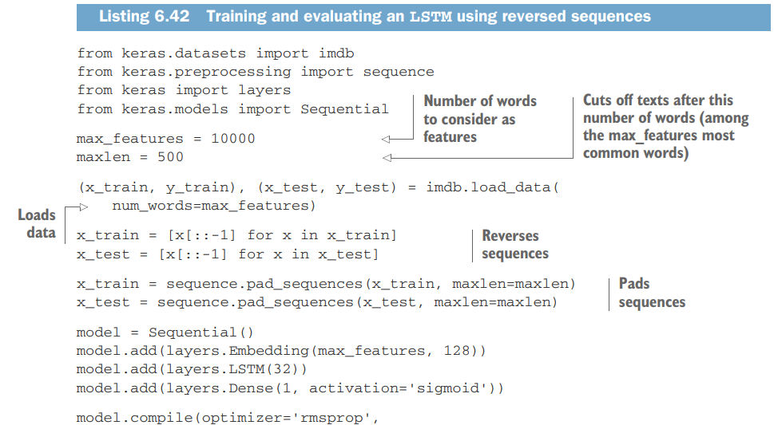


Slide 87
A bidirectional RNN exploits this idea to improve on the performance of chronological order RNNs.
It looks at its input sequence both ways, obtaining potentially richer representations and capturing patterns that may have been missed by the chronological-order version alone.

Slide 88
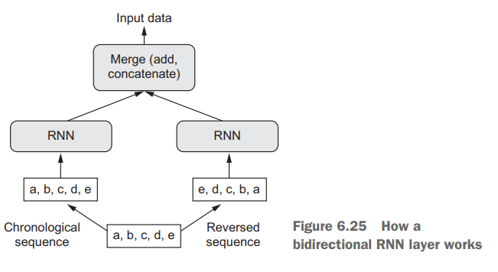

Slide 89
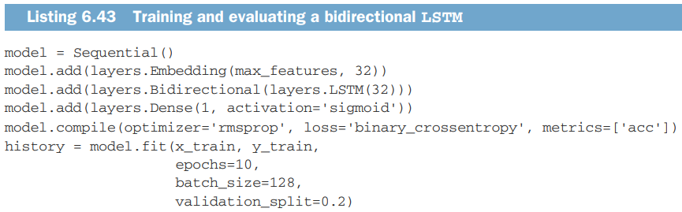

Slide 90


Slide 91
Going even further
Adjust the number of units in each recurrent layer in the stacked setup. The current choices are largely arbitrary and thus probably suboptimal.
Adjust the learning rate used by the RMSprop optimizer.
Try using LSTM layers instead of GRU layers.
Try using a bigger densely connected regressor on top of the recurrent layers: that is, a bigger Dense layer or even a stack of Dense layers.
Don’t forget to eventually run the best-performing models (in terms of validation MAE) on the test set! Otherwise, you’ll develop architectures that are overfitting to the validation set

Slide 92
Sequence processing with convnets
1D convnets can be competitive with RNNs on certain sequence-processing problems, usually at a considerably cheaper computational cost.
You can use 1D convolutions for extracting local 1D patches (subsequences) from sequences
Such 1D convolution layers can recognize local patterns in a sequence.
Because the same input transformation is performed on every patch, a pattern learned at a certain position in a sentence can later be recognized at a different position, making 1D convnets translation invariant

Slide 93


Slide 94
1D pooling for sequence data
The 2D pooling operation has a 1D equivalent: extracting 1D patches (subsequences) from an input and outputting the maximum value (max pooling) or average value (average pooling).
Just as with 2D convnets, this is used for reducing the length of 1D inputs (subsampling).

Slide 95


Slide 96
1D convnets are structured in the same way as their 2D counterparts, which you used in chapter 5: they consist of a stack of Conv1D and MaxPooling1D layers, ending in either a global pooling layer or a Flatten layer, that turn the 3D outputs into 2D outputs, allowing you to add one or more Dense layers to the model for classification or regression.
One difference, though, is the fact that you can afford to use larger convolution windows with 1D convnets.
With a 2D convolution layer, a 3 × 3 convolution window contains 3 × 3 = 9 feature vectors; but with a 1D convolution layer, a convolution window of size 3 contains only 3 feature vectors. You can thus easily afford 1D convolution windows of size 7 or 9.

Slide 97


Slide 98
Combining CNNs and RNNs to process long sequences
Because 1D convnets process input patches independently, they aren’t sensitive to the order of the timesteps
One way to evidence this weakness is to try 1D convnets on the temperature-forecasting problem, where order-sensitivity is key to producing good predictions.

Slide 99


Slide 100
One strategy to combine the speed and lightness of convnets with the order-sensitivity of RNNs is to use a 1D convnet as a preprocessing step before an RNN.
This is especially beneficial when you’re dealing with sequences that are so long they can’t realistically be processed with RNNs, such as sequences with thousands of steps.
The convnet will turn the long input sequence into much shorter (downsampled) sequences of higher-level features.
This sequence of extracted features then becomes the input to the RNN part of the network.

Slide 101


Slide 102


Slide 103



Slide 104
In the same way that 2D convnets perform well for processing visual patterns in 2D space, 1D convnets perform well for processing temporal patterns. They offer a faster alternative to RNNs on some problems, in particular naturallanguage processing tasks.
Typically, 1D convnets are structured much like their 2D equivalents from the world of computer vision: they consist of stacks of Conv1D layers and MaxPooling1D layers, ending in a global pooling operation or flattening operation.

Slide 105
Because RNNs are extremely expensive for processing very long sequences, but 1D convnets are cheap, it can be a good idea to use a 1D convnet as a preprocessing step before an RNN, shortening the sequence and extracting useful representations for the RNN to process.

